Slide 1
Wake Tech Libraries Resources & Services

Slide 2
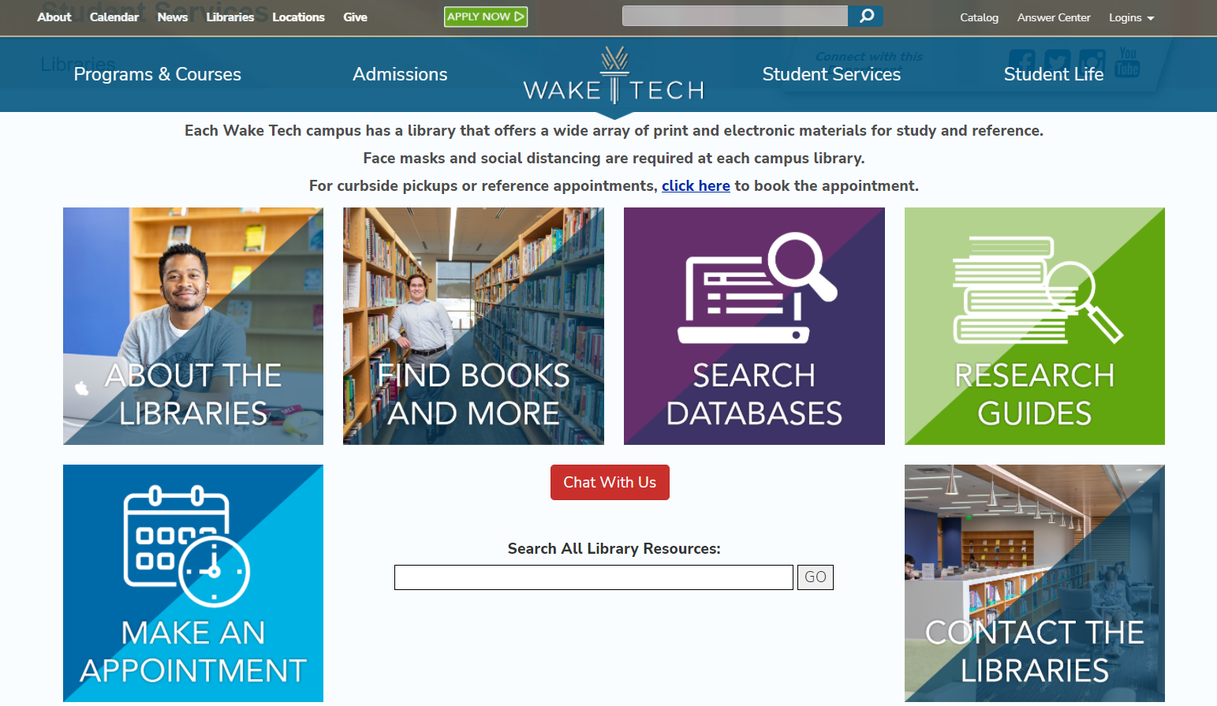

Slide 3
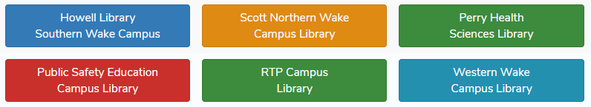

Wake Tech has 6 libraries, one on each campus.

Slide 4

Books, Audiobooks, and DVDs
The libraries have a wonderful collection of items including circulating, reference, and reserve items. There are also audiobooks, and DVD’s available at most campus libraries. All items can be found within the online catalog. Your Wake Tech ID is also used as your library card.

Slide 5
Interlibrary Loan
Can’t find a book in our library?
Check out our Interlibrary Loan service.
Books can be borrowed from any of the Wake Tech Libraries or from CCLINC, the community college library consortium. Once you locate a title in the libraries online catalog, click “Place Hold”. Enter WA followed by your seven digit Wake Tech ID number and your PIN (1234). We will email and/or call you when your book arrives. Contact the library to see if the item is available through Cooperating Raleigh Colleges (CRC).

Slide 6
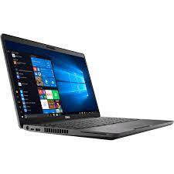
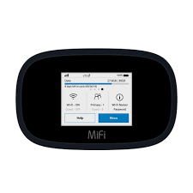
Laptops / Hotspots
Laptops and hotspots can be checked out for 3 weeks. You must be a current student with a Wake Tech ID, along with no fines or holds on your record. A Device Usage Agreement form must be signed before checking out any library devices. Visit the libraries website for more information or reserve a device using the Equipment Catalog.

Slide 7
Reserves
Course Reserves are put on reserve by faculty members to ensure those items are easily accessible to students, like textbooks, and other required reading or study materials. Reserve items are located behind the circulation desk and most are for in-library use only. All reserve materials must be checked out using a valid Wake Tech ID.

Slide 8

Reference Services
Need help looking for scholarly articles? You can make an appointment with a librarian to meet with you online or in the library. They can also show you how to successful organize your research strategy.
To make a Reference appointment or Curbside Pick-up for books, go to the following website:
https://researchguides.waketech.edu/appointments, select the library for your appointment, and fill out the online appointment form.

Slide 9
Library Instruction
Faculty can schedule instruction sessions in the library, classroom, or a virtual session online. Session topics range from Introduction to Resources & Services, Databases, to Effective Search Techniques.
Campus Instructional Contact Southern (Main) David Carter & Jake Ellis Scott Northern Nichole Nichols & Suvanida Duangudom Perry Health Sciences Brian Clossey & Anita Young Western Katy Hoffler Public Safety and Education Emily Bergen RTP Erik Sugg

Slide 10
Study Rooms
Need a place for group or individual study? Most libraries have available rooms or quiet study areas. The study rooms vary at each campus location. Please check the libraries for more information.

Slide 11
Computers/Printers/Copiers/Scanners
Computers are available for research, typing papers, printing, etc. A copy machine is available within most campus libraries. Copies cost 10 cents and the machine takes dollar bills. A scanner is also available. Fax machines are not available at any of the libraries.
* We ask that you limit your printing to 25 pages per day.

Slide 12

Databases
Wake Tech subscribes to a diverse collection of electronic full text databases that cover many different subject areas.
NCLive, JSTOR, SIRS, StatRef, and much more.
Off-Campus Users To use the research databases off campus, you must login using your Wake Tech username and password.
Your username is the first part of your email address (everything BEFORE @my.waketech.edu). Your password is the same as your email password.

Slide 13

Research Guides
Research Guides are a great place to start. Are created by the librarians and can be made based upon class assignments or subjects. Each guide will list books, databases and websites specific to your subject, along with other resources. As an example of one popular resource: Finding Reliable News Sources

Slide 14
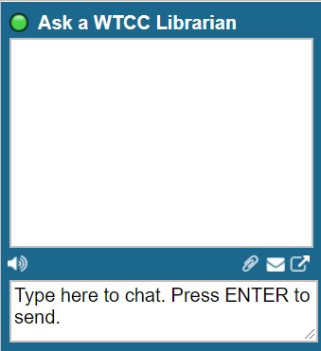
Ask a WTCC Librarian
Have questions? The library staff is available virtually to answer your questions. Throughout the libraries website, look for the “Ask a WTCC Librarian” box to ask a question.

Slide 15

Key Points
Wake Tech Libraries are open to all faculty, staff, students, Workforce Continuing Education Students, & community.
Your Wake Tech ID is used as your library card.
Wake County residents may use the library with a valid ID, showing a Wake County address. Residents must obtain a community borrower’s card, or a Wake Tech Instructional Support User’s card in order to use the library.
Computers are available, but students take priority. After 2:00pm, Wake County residents can use the computers if student use is not in high demand.
Books, Audiobooks, laptops & hotspots checkout for 3 weeks.
Nine (9) items is the maximum number of items that can be checked out at any time. Three (3) max for community borrowers.
All items may be renewed twice.
Food and drinks are not allowed in the library.
In accordance with campus policy, no children under the age of 15 are allowed inside the libraries.
Brochure Link: https://drive.google.com/file/d/1t5HkTaZcDrYMCFjwj3l8WhHo55Mxj3QP/view
Click on brochure to view -->

Slide 16

Questions

Slide 17

Thank You For Attending!

